Slide 1
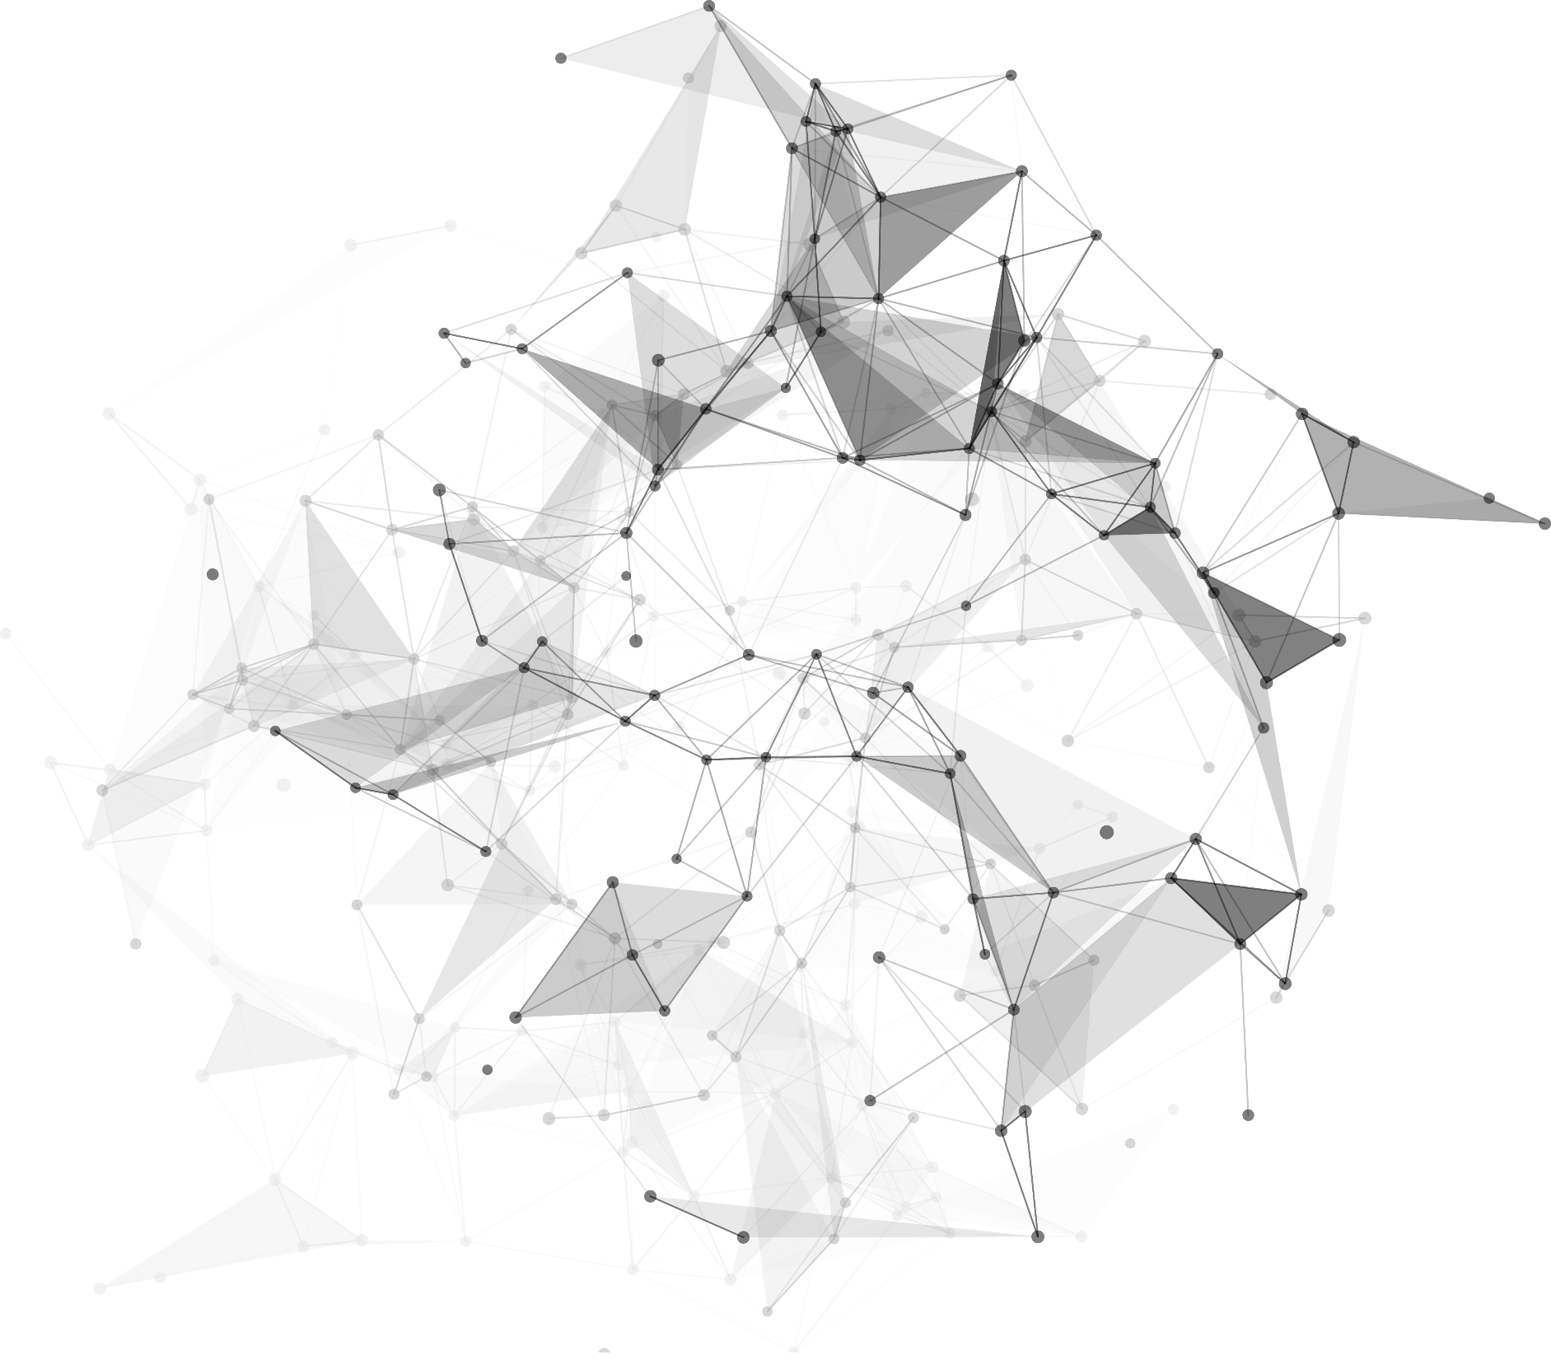
Facial Expression Recognition
LI YUHENG
GUO HONGXI
HUANG CHENXI
PAULSON PREMSINGH SAMSON DHANSINGH

Slide 2
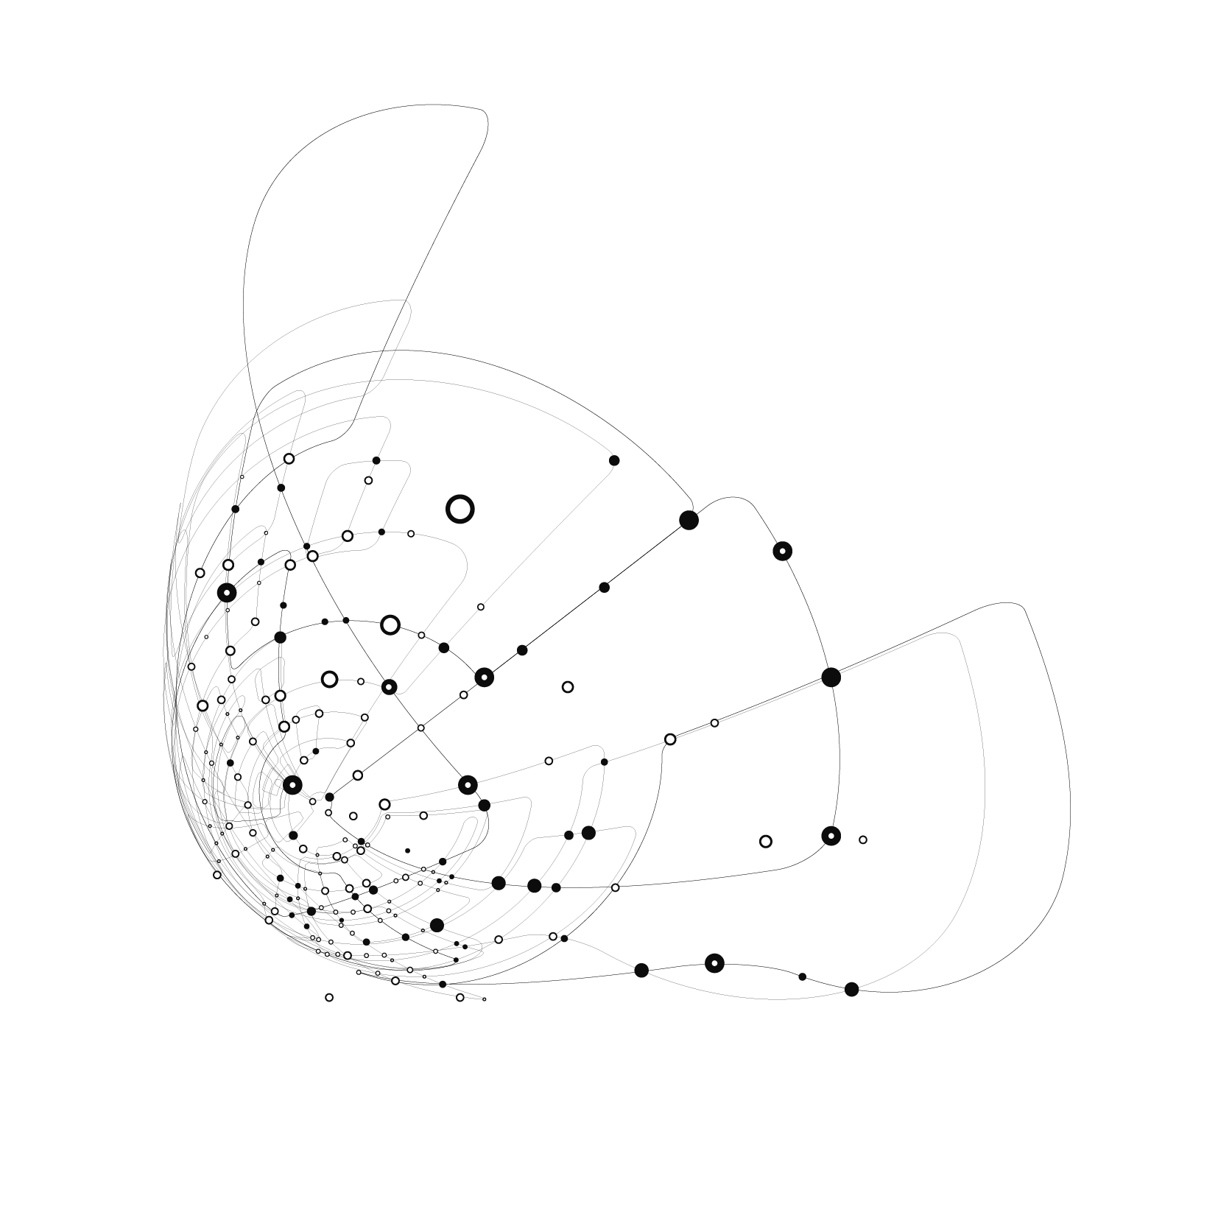
1
Summary
2
Tools/techniques
3
System design / Models
Outline
4
System performance
5
Conclusion

Slide 3
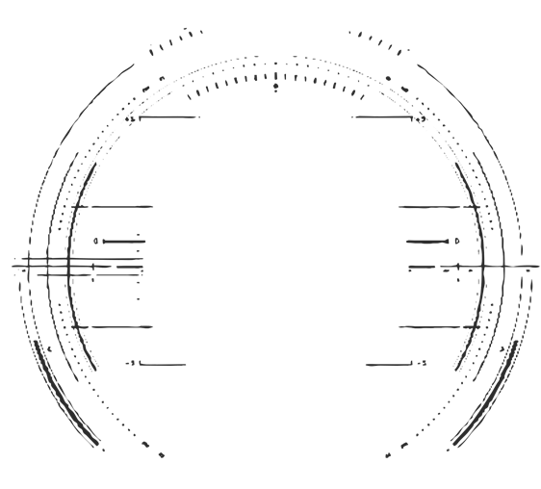
Part 1
summary

Slide 4
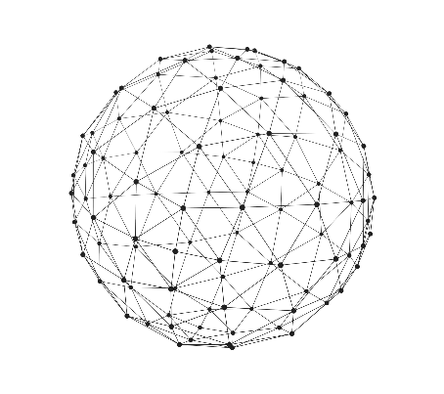
EXECUTIVE SUMMARY
Emotion:
Example:
a way/manifestation of people expressing their wishes or themselves in daily life, work or study
In the service field： judge consumer satisfaction
In the class： get the student’s reaction to the difficulty of the knowledge
In the medical industry： determine whether the patient is abnormal
In a criminal investigation： judge whether a criminal suspect is lying,

Slide 5
DESCRIPTION
When making commercials, producers often have a headache：
how to know the expected result from the audience
If the audience can have a deeper impression of the brand and product after watching the advertisement
Is the user showing interest in the specific details
Expression recognition can help ad makers solve this vexing problem
acquire viewers’ privacy
invites viewers to watch the commercial ads and captures facial expressions at specific segments of the ad
use the expression recognition system to test the viewer's emotions to determine whether the ad meets expectations

Slide 6



Project Objective
build a complete and user-friendly facial expression recognition system
categorize each face based on the emotion shown in the facial expression into one of seven categories (Angry, Disgust, Fear, Happy, Sad, Surprise, Neutral), but do not automatically give us a new facial expression word
Facial expression recognition
Picture
Video
Real-time front camera

Slide 7
Part 2
Tools/
techniques

Slide 8
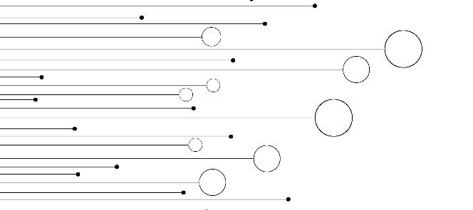

Data Preprocess
Select the database
MMA Facial Expression Dataset
Used python to do the preprocessing work, and imported cv2 to read the images
Used numbers 0-6 to represent 7 different expressions and labeled it to every image in a 2d array, and separated it into input and output for all 3 kinds(train, valid, and test). And finally, we use np. save() to save the NumPy matrix for model training in the next step

Slide 9

Model,Frontend,Backend
Front-end
Bootstrap
Model Building & Training
Backend
use the sequential model from Keras to build our neural network
use the GPU on Google Colab to train our system, and the building process and the basic structure of our model
Flask

Slide 10
Part 3
System design / Models

Slide 11

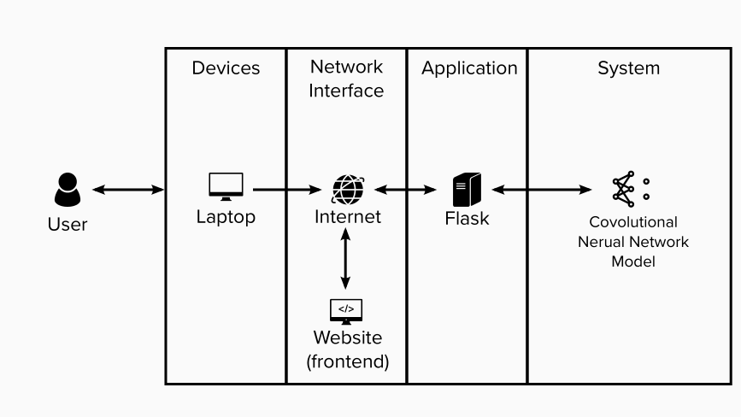
System Architecture
accesses our web pages
upload image/video or front camera to capture the image
image is transferred to the backend serve
the image as an input into our well-trained model
the model gives feedback
The information is transferred to the frontend pages

Slide 12
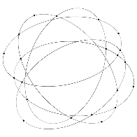
Model
Model building
Problem: depth of the model is not deep enough and the dropout rate is a little bit low — resulted in the low performance of model
Solution: Added convolutional layers and increase the value of dropout rate
Model training: over-fitting
Problem: over-fitting
Solution: adjusted the learning rate and upsized the batch size

Slide 13

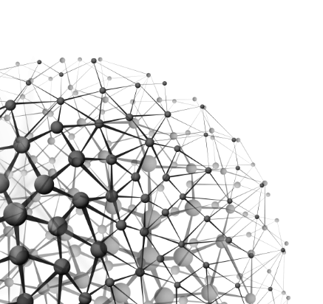
Web Application
1
Upload image:
A user uploads a picture from his/her own computer. The web application performs FER and shows a list of probabilities of emotions that the picture may expose
2
Upload video:
A user uploads a mp4 video file to the web application. The web application performs FER on the video and generates a new video with real-time FER results. The user can play the FER video online or download it.
3
Real-time camera：
A user uses the front camera from the computers to let the web application get real-time video. The web application displays real-time FER results, including respective prediction confidence for seven different emotions and a corresponding emoji for the identified emotion.

Slide 14
Part 4
System performance

Slide 15
System performance
Advantages
SYSTEM’S INTELLIGENCE & ROBUSTNESS
Very intelligent :does not need the user to manually capture the human face in the target image, but can automatically capture the centered human face if the image contains 2 or more human faces.
Very robust: activate the front camera in advance before starting the system; prompt the user if the user uploads the unknown format file
SCALABILITY
very convenient to update built-in human face detection methods and models in the whole system
Disadvantages
Does not support the upload of bulk files

Slide 16
Part 5
Conclusion

Slide 17
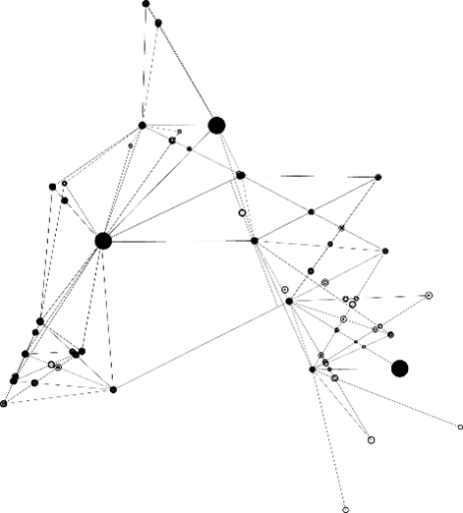


Conclusion
A facial expression recognition system can recognize/analyse facial emotions in pictures, video, and Real-time camera.
build a local system
deploy the whole system to the web application
use Dlib in Python as our facial detection method
use CNN to train facial expression recognition model

Slide 18
Thanks

